Slide 1
Cluster Analysis
OPIM 5604 – Predictive Modeling
Jennifer Eigo

Slide 2
Clustering: The Main Idea
Goal: Form groups (clusters) of similar records
Used for segmenting markets into groups of similar customers
Example: Claritas segmented US neighborhoods based on demographics and income: “Furs & station wagons,” “Money & Brains”, …

Slide 3
Example: Toyota Corolla
Scenario: Business owner has several used car dealerships that cater to different customer preferences
Goal: Find clusters of similar cars to better place car inventory across dealerships
Data: small sample - 150 cars, 6 variables
    Age_08_04 CC
    KM Doors
    HP Weight

Slide 4
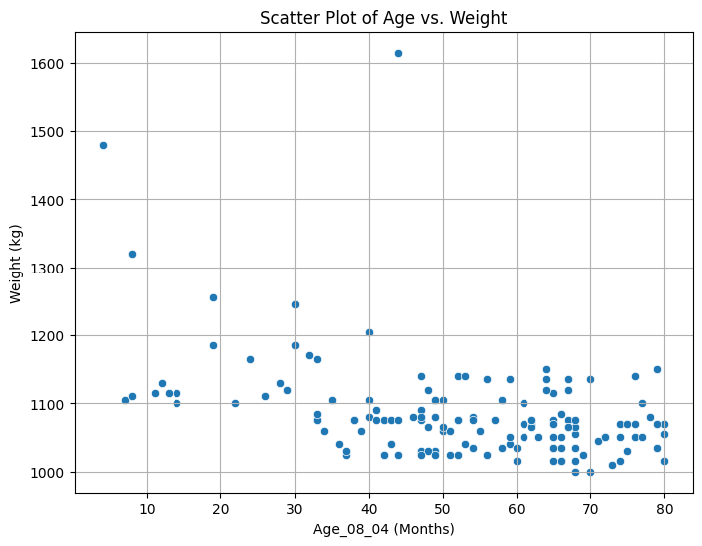
Age_08_04 & Weight:
3 rough clusters can be seen
Heaviest Cars
Mid-weight New Cars
Light Old Cars

Slide 5
Extension to More Than 2 Dimensions
In prior example, clustering was done by eye
Multiple dimensions require formal algorithm with
  A distance measure
  A way to use the distance measure in forming clusters
We will consider two algorithms:
  hierarchical and
  non-hierarchical (K-means)

Slide 6
Hierarchical Clustering

Slide 7
Hierarchical Methods
Agglomerative Methods
  Begin with n-clusters (each record its own cluster)
  Keep joining records into clusters until one cluster is left (the entire data set)
  Most popular
Divisive Methods
  Start with one all-inclusive cluster
  Repeatedly divide into smaller clusters

Slide 8
Measuring Distance
Between Records

Slide 9

Distance Between Two Records
Euclidean Distance is most popular:
Name | Age | Height | Weight
Bob | 25 | 72 | 210
Matt | 27 | 68 | 175
Distance =
Distance = 35.26

Slide 10
Normalizing
Problem: Raw distance measures are highly influenced by scale of measurements
Bob to Matt = 35 Bob to Mark = 25,000 Matt to Mark = 25,000
Solution: normalize (standardize) the data first
  Subtract mean, divide by std. deviation
  Also called z-scores
Name | Age | Height | Weight | Income
Bob | 25 | 72 | 210 | 100,000
Matt | 27 | 68 | 175 | 100,000
Mark | 27 | 68 | 175 | 75,000

Slide 11
Example: Normalization
First find mean and the standard deviation of the column. For Age_08_04:
Average = 52.62 months
Standard Deviation = 18.13
For each row, subtract the mean then divide by the standard deviation.
Normalized age for first car = (24-52.62)/18.13
= -1.58

Slide 12
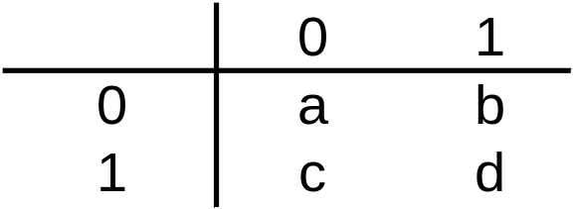
For Categorical Data: Similarity
To measure the distance between records in terms of several 0/1 variables, create table with counts:
Similarity metrics based on this table:
Simple Matching Coefficient (SMC) = (a+d)/n
Jaccard’s Similarity Coefficient = d/(b+c+d)
  Use in cases where a matching “1” is much greater evidence of similarity than matching “0”
  Ignores mutual absence of a category

Slide 13
For Categorical Data: Similarity
Name | 4 Yr Degree | Home Owner | Employed | Married | Children
Bob | 0 | 1 | 1 | 1 | 0
Matt | 1 | 0 | 1 | 0 | 0
Bob
Matt
1
2
1
1
Matching Coef. = (a+d)/n = (1+1)/5 = 0.4
Jaccard’s Coef. = d/(b+c+d) = 1/(2+1+1) = 0.25

Slide 14
Measuring Distance
Between Clusters

Slide 15
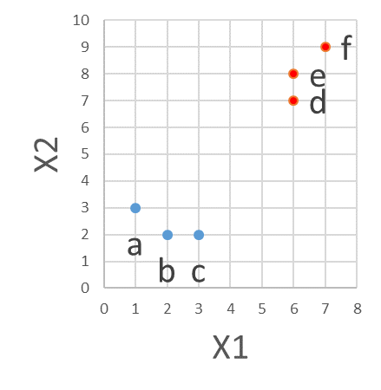
Minimum Distance
(Cluster A to Cluster B)
Also called single linkage
Distance between two clusters is the distance between the pair of records A_{i} and B_{j} that are closest
Min Dist from blue cluster
to red cluster is the distance
between points c and d
Dist = sqrt((3-6)^2 + (2-7)^2)
Dist = sqrt(9 + 25) = 5.8

Slide 16
Maximum Distance
(Cluster A to Cluster B)
Also called complete linkage
Distance between two clusters is the distance between the pair of records A_{i} and B_{j} that are farthest from each other
Max Dist from blue cluster
to red cluster is the distance
between points b and f
Dist = sqrt((2-7)^2 + (2-9)^2)
Dist = sqrt(25 + 49) = 8.6

Slide 17
Average Distance
Also called average linkage
Distance between two clusters is the average of all possible pair-wise distances
Avg Dist from blue cluster
to red cluster is the average of
the 9 distances between points
a & d, a & e, a & f,
b & d, b & e, b & f,
c & d, c & e, c & f
Dist = 7.2

Slide 18
Centroid Distance
Distance between two clusters is the distance between the two cluster centroids
Centroid is the vector of variable averages for all records in a cluster
Centroid Dist from blue cluster
to red cluster is the distance
between the center of each
Blue center = avg X1, avg X2 = 2, 2.3
Red center = avg X1, avg X2 = 6.3, 8
Dist = sqrt((2-6.3)^2 + (2.3-8)^2)
Dist = sqrt(18.49 + 32.49) = 7.14

Slide 19
Ward’s Method
Another common distance measure
Considers loss of information when observations are clustered together
Uses error sum of squares (ESS) to measure the difference between observations and the centroid

Slide 20
The Hierarchical Clustering (Using Agglomerative Method)
Steps:
Start with n clusters (each record is its own cluster)
Merge two closest records into one cluster
At each successive step, the two clusters closest to each other are merged

Slide 21
Hierarchical Example - Centroid
Cluster people based on birth month.
Sample: Six random people born in months 7, 9, 2, 12, 4, and 1
Step 1: Each person is in their own cluster of 1.
Step 2: Merge two closest records into one cluster.
7
9
2
12
4
1
← 6 Clusters
7
9
2
12
4
1
← 5 Clusters
7
9
2, 1
12
4
Centroid = 1.5

Slide 22
Hierarchical Example - Centroid
Step 3: Repeat merging two closest clusters.
← 5 Clusters
← 5 Clusters
7
9
2, 1
12
4
7
9
2, 1
12
4
Centroid = 1.5
Centroid = 1.5
← 4 Clusters
← 4 Clusters
7, 9
2, 1
12
4
7, 9
2, 1
12
4
Centroid = 1.5
Centroid = 8
Centroid = 1.5
Centroid = 8
← 3 Clusters
← 3 Clusters
7, 9
2, 1, 4
12
7, 9
2, 1, 4
12
Centroid = 8
Centroid = 2.3
Centroid = 8
Centroid = 2.3
← 2 Clusters
← 2 Clusters
7, 9, 12
2, 1, 4
7, 9, 12
2, 1, 4
Centroid = 2.3
Centroid = 9.3
Centroid = 2.3
Centroid = 9.3
← 1 Cluster
← 1 Cluster
7, 9, 12, 2, 1, 4
7, 9, 12, 2, 1, 4
Centroid = 5.8
Centroid = 5.8

Slide 23
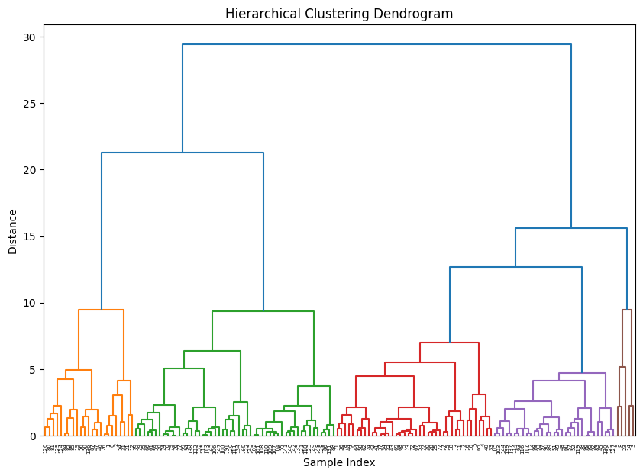
Dendrograms Illustrate Steps
Horizontal lines show the joins between two groups.
The height of the horizontal line shows the distance between the two groups being joined.

Slide 24
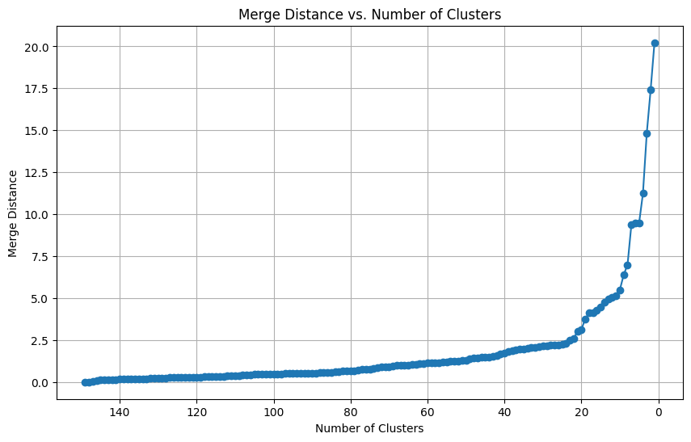
Choosing Optimal # of Clusters
Plot the merge distance by cluster count, descending.
Look for the elbow in the line.
This shows
where the next
merge is
increasingly
different.
In this
example, 5
clusters looks
good.

Slide 25
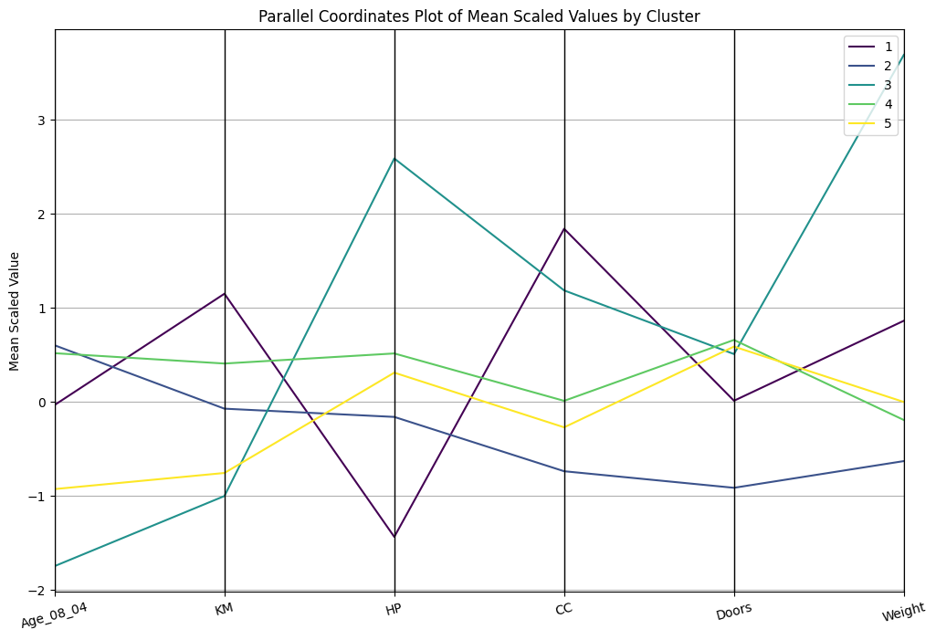
Exploring Cluster Attributes
Parallel plots show the cluster means

Slide 26
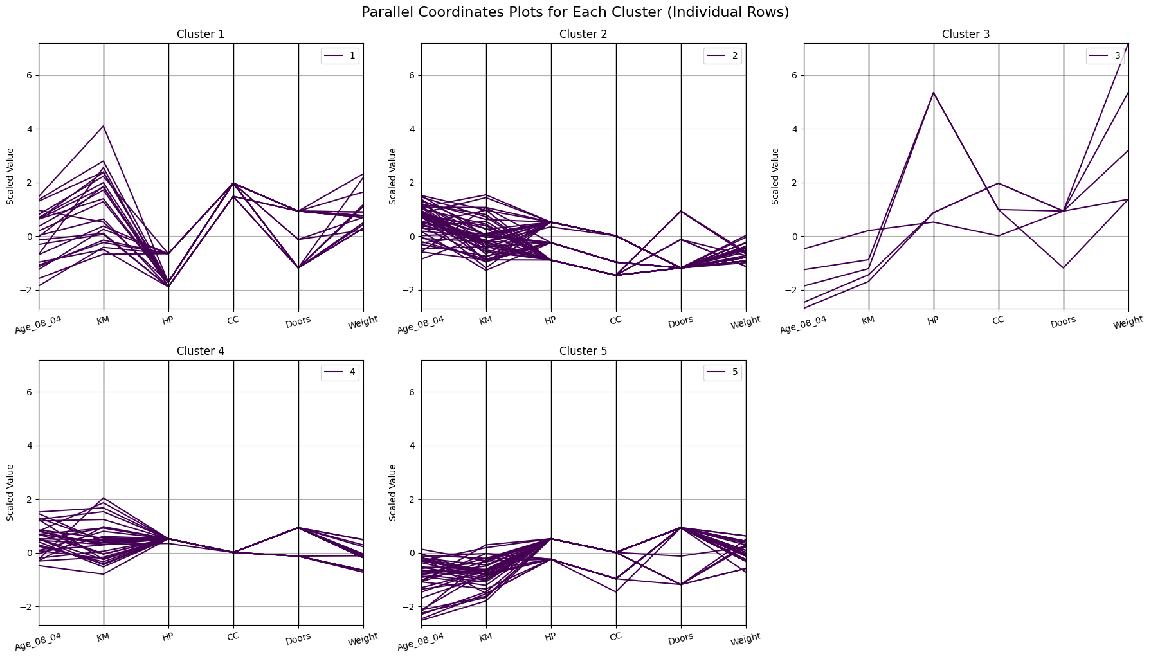
Row Level Plots by Cluster

Slide 27
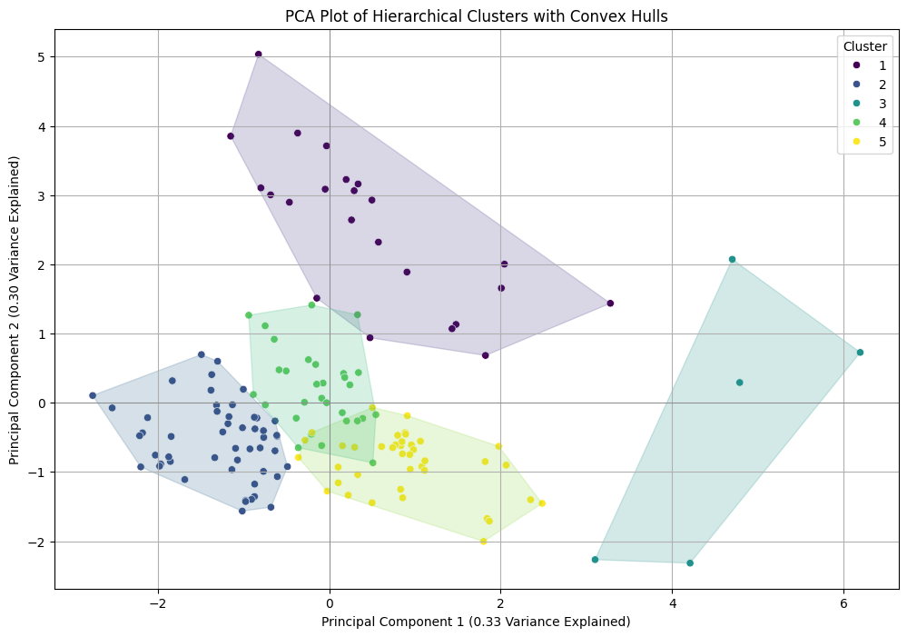
Checking Cluster Separation

Slide 28
Validating Clusters

Slide 29
Interpreting Clusters
Goal: obtain meaningful and useful clusters
Caveats:
  (1) Random chance can often produce apparent clusters
  (2) Different cluster methods produce different results
Solutions:
Obtain summary statistics
Also review clusters in terms of variables not used in clustering
Label the cluster (e.g. clustering of financial firms in 2008 might yield label like “midsize, sub-prime loser”)

Slide 30
Desirable Cluster Features
Stability
  Are clusters and cluster assignments sensitive to slight changes in inputs?
  Are cluster assignments in partition B similar to partition A?
Separation
  check ratio of between-cluster variation to within-cluster variation (higher is better)

Slide 31
Nonhierarchical Clustering:
K-Means Clustering

Slide 32
K-Means Clustering Algorithm
Choose # of clusters desired, k
Start with a partition into k clusters
    Often based on random selection of k centroids
At each step, move each record to cluster with closest centroid
Recompute centroids, repeat step 3
Stop when moving records increases within-cluster dispersion

Slide 33
K-Means Example - Centroid
Step 1: Cluster people based on birth day. K = 2
Sample: Six random people born on the 23rd, 14th, 2nd, 11th, 7th, and 25th.
Step 2: Randomly split the data into 2 clusters.
Step 3: Each record checks to see which centroid it is closest to and decides to move or stay.
23, 14, 2
11, 7, 25
Centroid = 13
Centroid = 14.3
23 is closest to 14.3 so move. | 11 is closest to 13 so move.
14 is closest to 14.3 so move. | 7 is closest to 13 so move.
2 is closest to 13 so stay. | 25 is closest to 14.3 so stay.

Slide 34
K-Means Example - Centroid
Step 4: Recompute centroids and recheck records compared to centroids.
Step 5: Stop when additional moves would increase within-cluster dispersion.
2, 11, 7
25, 23, 14
Centroid = 6.7
Centroid = 20.7
2 is closest to 6.7 so stay. | 25 is closest to 20.7 so stay.
11 is closest to 6.7 so stay. | 23 is closest to 20.7 so stay.
7 is closest to 6.7 so stay. | 14 is closest to 20.7 so stay.

Slide 35
K-means Algorithm:
Choosing k and Initial Partitioning
Choose k based on the how results will be used
  e.g., “How many market segments do we want?”
3 is very common xkcd K-means Clustering Comic
Also experiment with slightly different k’s
Initial partition into clusters can be random, or based on domain knowledge
  If random partition, repeat the process with different random partitions

Slide 36
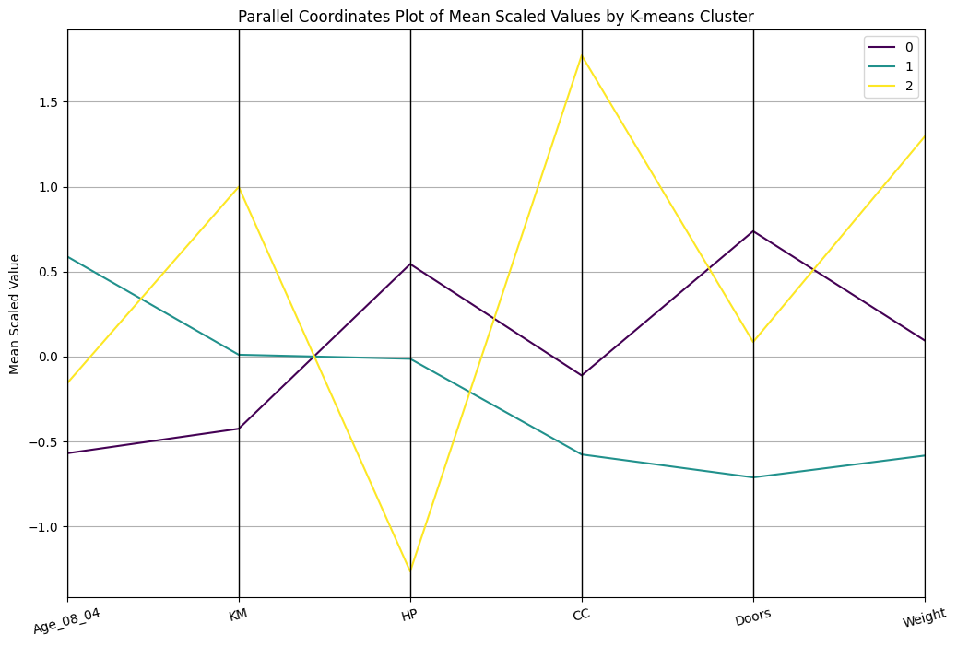
K-means output (k = 3)

Slide 37
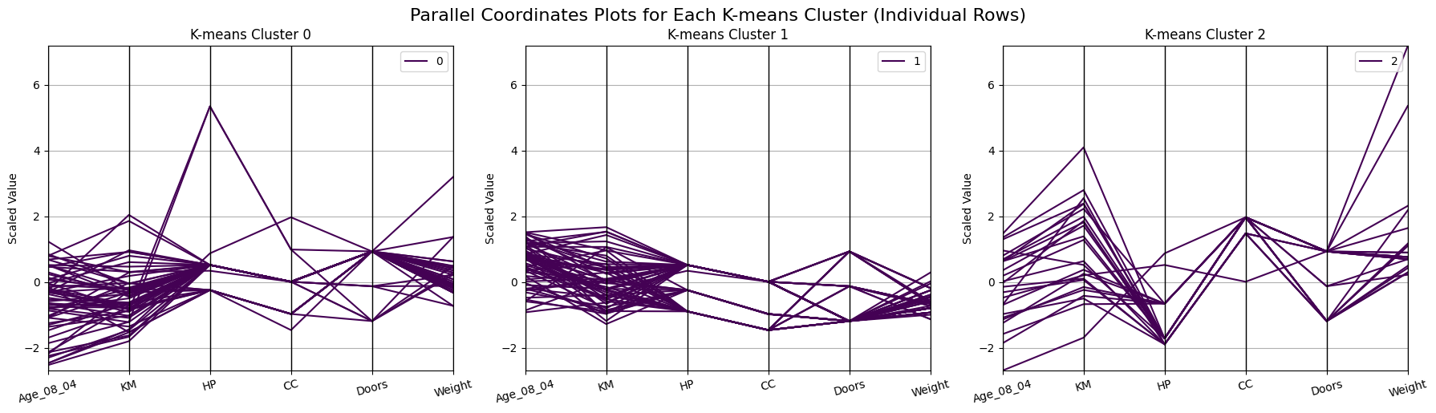
Visualizing Clusters’ Rows

Slide 38
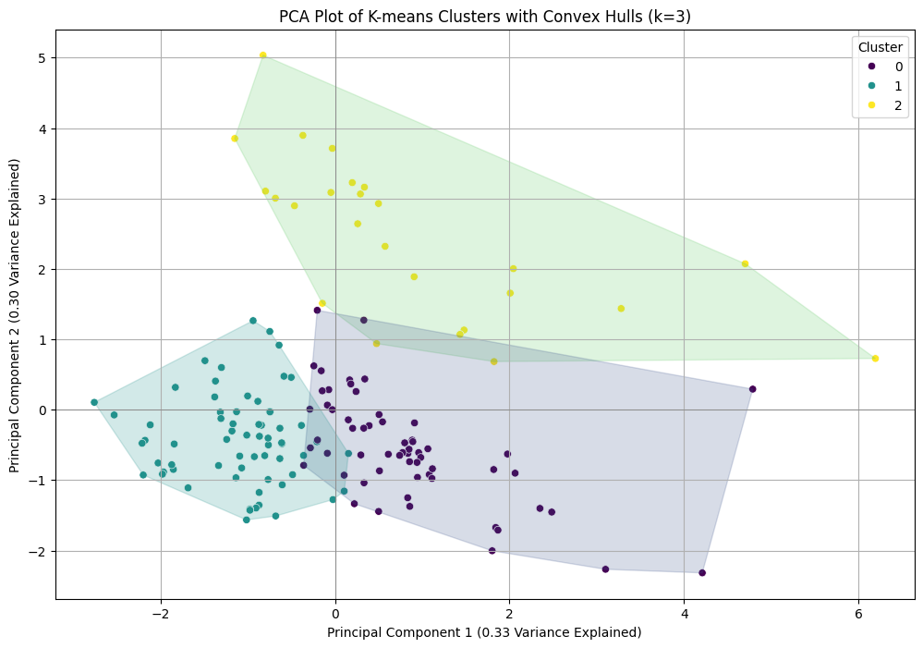
Checking Cluster Separation

Slide 39
Summary
Cluster analysis is an exploratory tool
It is useful only when it produces meaningful clusters
Hierarchical clustering gives visual representation of different levels of clustering
Non-hierarchical clustering is computationally cheap and more stable (good with larger data sets); requires user to set k
Can use both methods
Be wary of chance results; data may not have definitive “real” clusters

